Slide 1
DealPod
Group buying for everyday shoppers
The problem
The solution
Two students need the same laptop. They shop separately, and sellers never see their combined demand.
DealPod pools buyers so sellers can offer a group price. Each buyer approves their own PayPal payment.

Slide 2
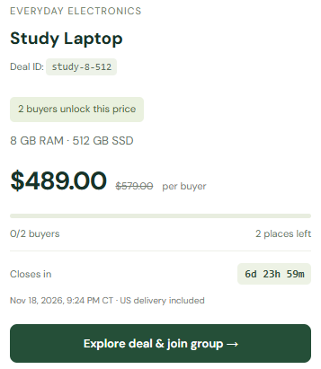
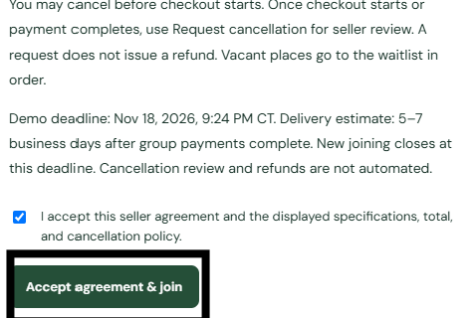
Feature 1 / Join an existing deal
Mia joins a $489 laptop deal
The offer needs two buyers
Mia reviews the seller’s terms
Accepting reserves her spot.

Slide 3


Feature 1 / Join an existing deal
Sam joins and PayPal unlocks
Before Sam joins
After Sam joins
2 of 2 buyers. The group is ready.
Each buyer approves their own $489 payment.

Slide 4
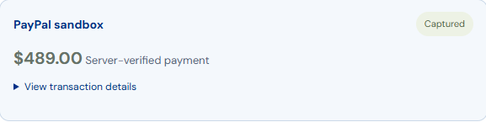
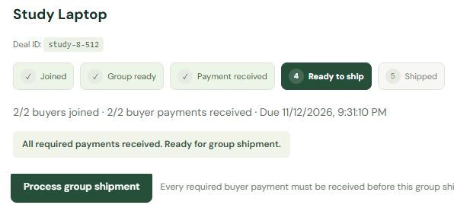

Feature 1 / Join an existing deal
The seller ships after both payments
Seller view / Ready to ship
Payment capture and buyer tracking
PayPal sandbox payments and demo shipment

Slide 5
Feature 2 / Live demo
When no deal fits
Save as an interest
Submit request to sellers
Get an alert when a matching deal appears.
DealPod groups similar requests so a seller can review and publish a new offer.

Slide 6
DealPod
Thank you
Buyers can share a group price.
Sellers can see demand they might have missed.

